Slide 1
DESIGN FOR X, PRODUCT DESIGN & DEVELOPMENT
B.Tech First Year–
Teaching Scheme Theory: 02 Hours/Week

Slide 2
SYLLABUS
Design for X & DT
Design Thinking, Development Stages-TRL, MRL, IRL aspects, Concepts of Quality & Reliability in product design &amp; Development, House of Quality, Quality Function Deployment (QFD), Failure Modes &amp; Effects Analysis (FMEA), Types of FMEA, Robust Design, Case studies Other DFX areas from various fields (IT, Instru., Elex, etc.)

Slide 3
Quality Function Deployment
Quality - Meeting Customer Requirements
Function - What Must Be Done - Focusing the attention
Deployment - Who Will Do It, How, When

Slide 4
Quality Function Deployment (QFD)
Collection of matrices that converts the needs of the customer into technical specifications at all stages of the design and manufacture process.
Customer requirements (prioritised )
Competitive product evaluation
Technical Requirements
Relationships of 1 & 3
Interrelationship between Technical Requirements
Targets for new product
5
3
1
4
2
6
House of Quality

Slide 5
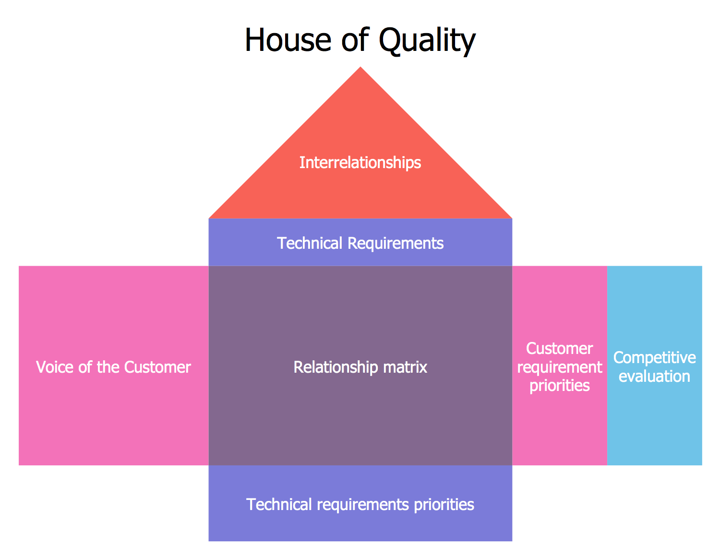

Slide 6
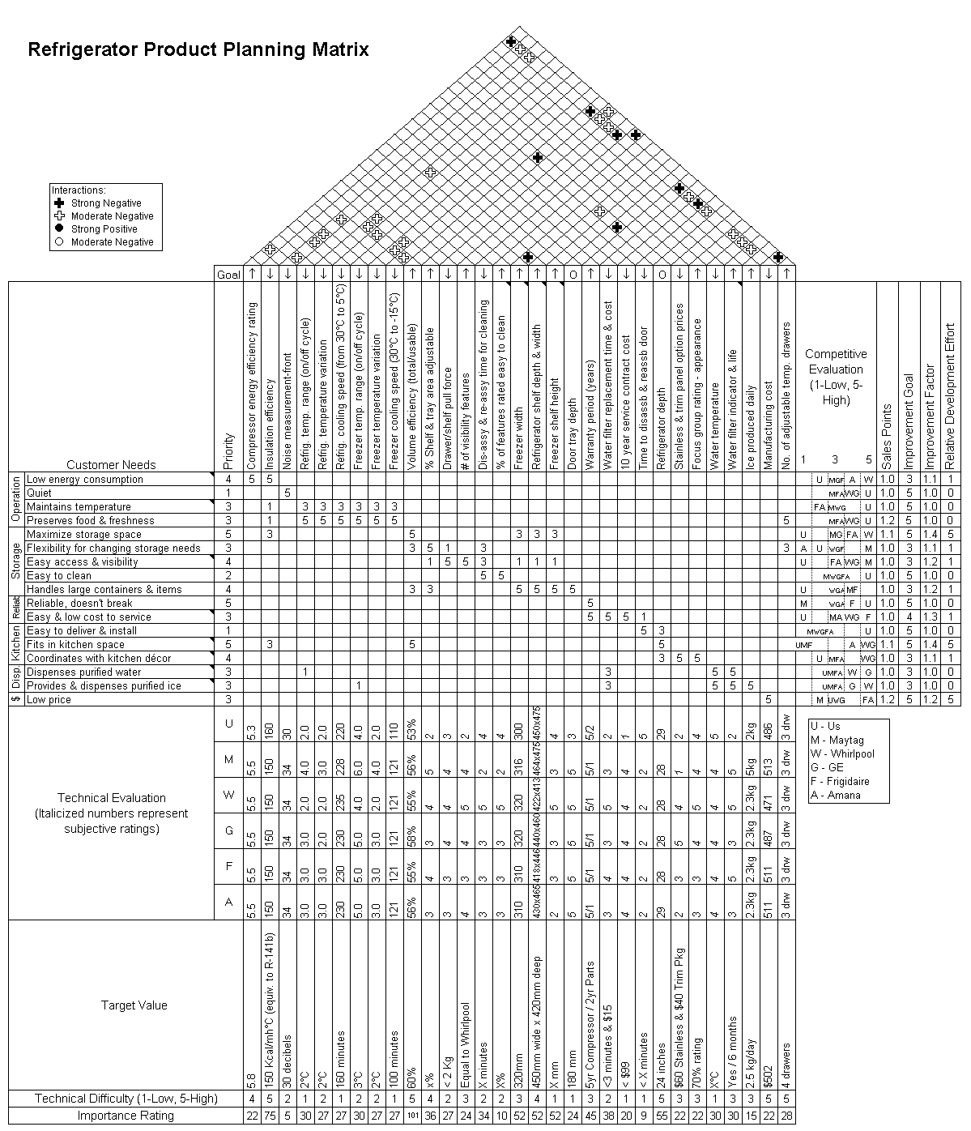

Slide 7
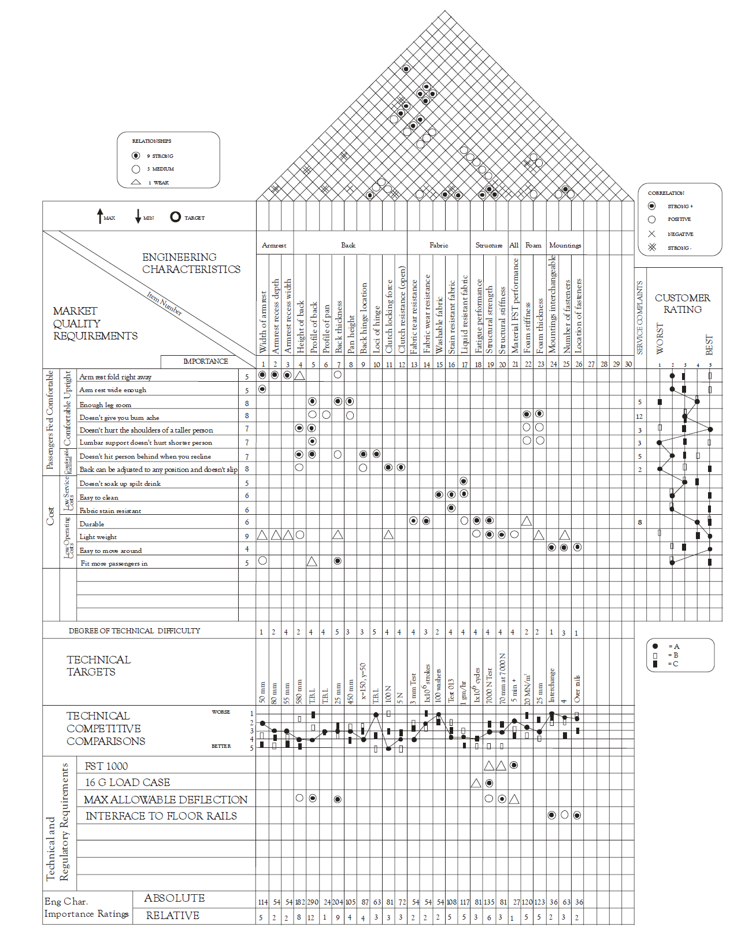
AIRCRAFT SEAT

Slide 8
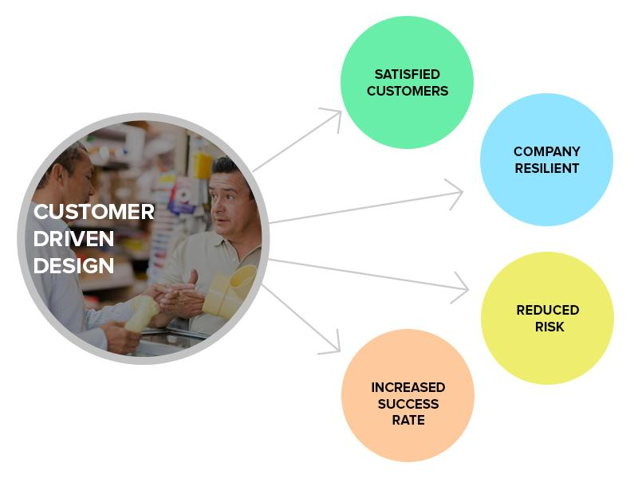
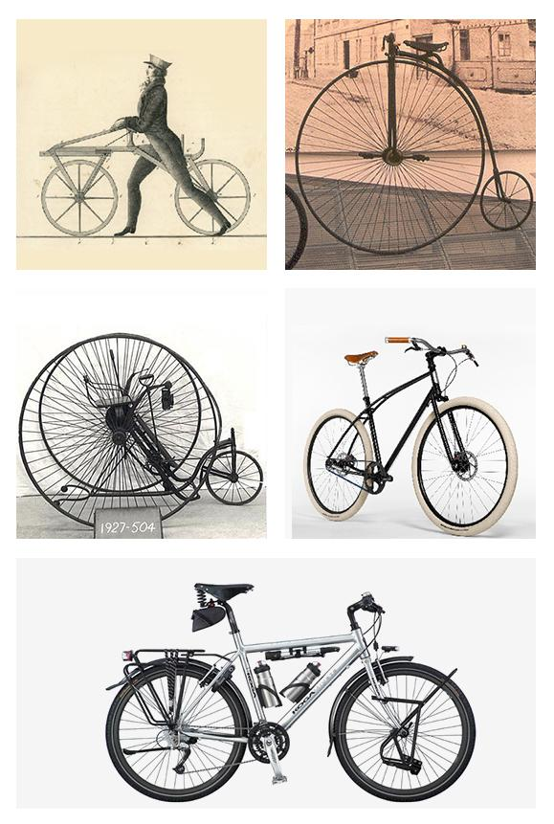
PURPOSE OF QFD
To get Higher Quality products to market Faster and at a lower cost
To achieve customer driven product design
It will provide a tracking system for future design or process improvements.

Slide 9
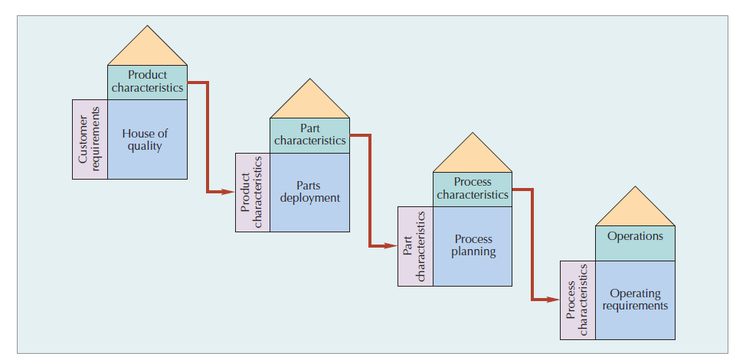
A SERIES OF CONNECTED QFD HOUSES

Slide 10
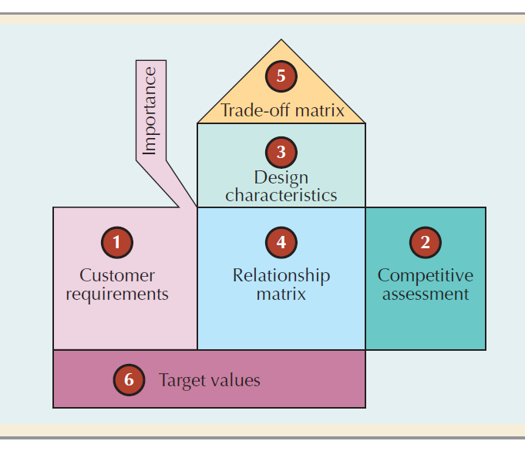
HOUSE OF QUALITY

Slide 11
COMPANIES USE QFD
Ford,
GM,
Chrysler,
DEC,
TI,
3M,
HP,
AT&T Bell Labs,
Novatel,
Xerox,
Exxon and Dow.
Nissan,
Toyota,
Komatsu,
Nippondenso,
Honda

Slide 12
CUSTOMER REQUIREMENTS
5
3
To stay in business 🡪 Sell products or
services🡪 Continual Customer satisfaction 🡪
Fulfill the customers’ requirements 🡪
Gathering and use of customer requirements
1
4
2
6
It is essential, to gather true customer requirements
The Customer Chain e.g. Breakfast Cereal, Aircraft Seat
Internal customers requirements which may then lead to a compromise on an External customer requirements
Immediate Customer and User
What do we mean by ‘Customer’ in QFD
Those who bought our products
Those who bought competitors’ products
Those who switched to our competitor
Those who are satisfied
Those who are not satisfied
Obtaining Customer Requirements
Primary and Secondary data

Slide 13
CUSTOMER (CHAIN) REQUIREMENTS FOR THE AIRCRAFT SEAT
5
3
1
Passenger
Comfortable, does not give you bum ache.
Enough leg room.
Lumbar support does not hurt short person.
Does not burn.
Hole in tray for coffee cup.
Comfortable seat belt.
Seat belt feels safe.
Magazines can be easily removed from rack.
Comfortable when you recline.
Does not hit person behind when you recline.
Back can be adjusted to any position and does not slip.
Not dirty.
Nice colour.
Does not soak up a spilt drink.
Does not make you sweat.
Arm rests not too narrow.
Arm rest folds right away.
4
2
Aircraft Manufacturer
Cheap.
Light weight.
Durable.
Easy to fit in plane.
Safe in crash.
Meets CNC simulatory requirements.
Airline
Easy/cheap to refit.
Easy to clean.
Easy to move around.
Fit more passengers in.
Passengers feel comfortable.
Fabric in certain colours.
Fabric stain resistant.
Meets CNC simulatory requirements.
Long life.
Low operating cost.
Cheap to service.
6

Slide 14
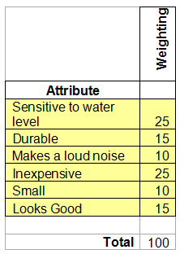
Example: Water-pond Alarm
Identify customer requirement and prioritise them (scale or %)
5
3
1
4
2
6

Slide 15
Competitive Product Evaluation
5
3
1
2
 |  | Competitive Assessment
Attribute |  | 1 | 2 | 3 | 4 | 5
Sensitive to water level | 25 |  |  | A | X
Durable | 15 |  | A | B | X
Makes a loud noise | 10 |  | B | X | A
Inexpensive | 25 |  |  | B | A | X
Small | 10 |  | B | A | X
Looks Good | 15 |  | B | X | A
4
6

Slide 16
TECHNICAL OR ENGG. REQUIREMENTS
5
3
1
Attribute
Sensitive to water level | 25 | ++ | + |  | ++
Durable | 15 |  |  | +
Makes a loud noise | 10 | + | -
Inexpensive | 25 | -- |  | + | --
Small | 10 | - | -
Looks Good | 15 |  |  | +
4
2
Complexity of circuit
Material for casing
Energy Efficiency
6
Cost of Sensor
Weighting

Slide 17
Relationships of 1 & 3
5
3
1
4
2
Attribute
Sensitive to water level | 25 | ++ | + |  | ++
Durable | 15 |  |  | +
Makes a loud noise | 10 | + | -
Inexpensive | 25 | -- |  | + | --
Small | 10 | - | -
Looks Good | 15 |  |  | +
Sensitivity to water level is likely to be very dependent on complexity of circuit
Complexity of circuit
6
Material for casing
Energy Efficiency
Cost of Sensor
Weighting
Legend:
Positive correlation +
Strong positive correlation ++
None
Negative correlation -
Strong Negative correlation - -
Increasing the noise level could reduce the energy efficiency

Slide 18
Relationships of 1 & 3
5
3
A complex circuit and quality sensor could increase cost of product
1
4
2
Attribute
Sensitive to water level | 25 | ++ | + |  | ++
Durable | 15 |  |  | +
Makes a loud noise | 10 | + | -
Inexpensive | 25 | -- |  | + | --
Small | 10 | - | -
Looks Good | 15 |  |  | +
The choice of material will affect the durability of the product
Complexity of circuit
6
Material for casing
Energy Efficiency
Cost of Sensor
Weighting

Slide 19
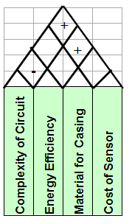
Interrelationship between Technical Requirements
5
3
A good quality sensor could improve energy efficiency
1
4
2
6
Increasing complexity of circuit could require a more costly sensor
Complex circuit (more parts) could reduce energy efficiency

Slide 20
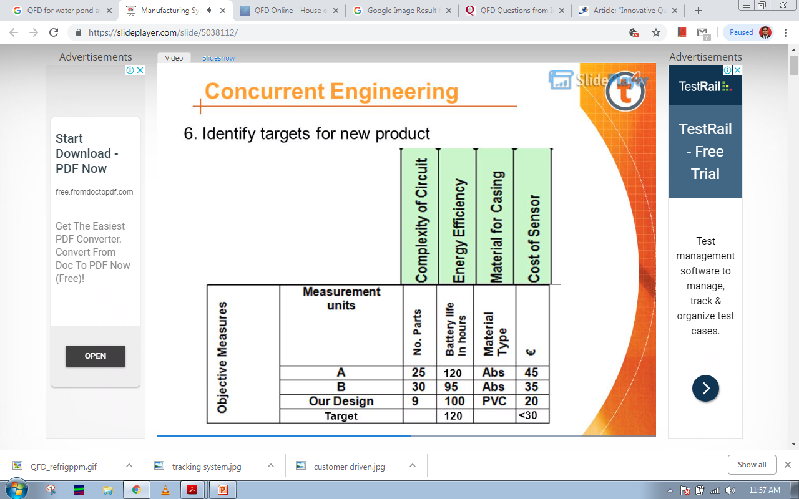
Targets for New Product
5
3
1
4
2
6
Complexity of circuit
Material for casing
Energy Efficiency
Cost of Sensor

Slide 21
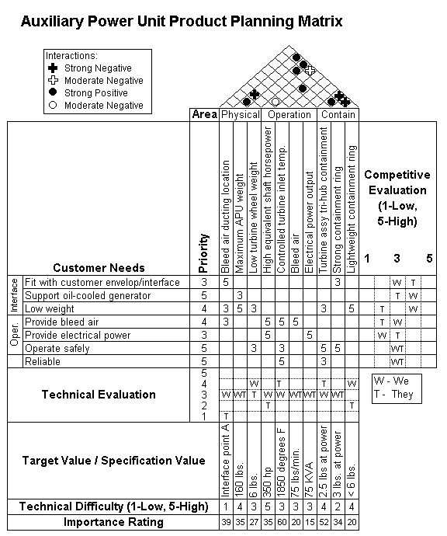

Slide 23
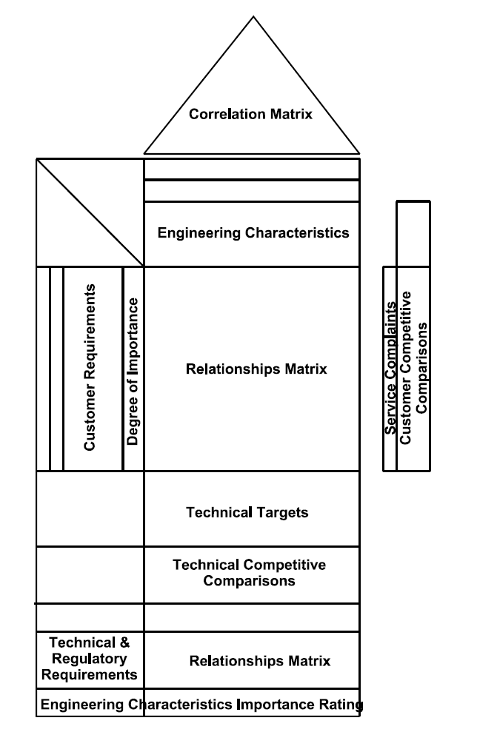

Slide 24
Example:
A washing machine to last for ten years in normal use.
Expected typical household use: three times a week for a wash cycle that will last for 2 hours on average.
What type of test should be used?
How long must the machine survive during the test?
Total hours life required for the machine is:
2 hours/wash x 3 washes/week x 52 weeks/year x 10 years = 3120 hours
Use a quantitative accelerated test. Run the machine constantly for 3120 hours

Slide 25
Sample Paper: HL
Explain why accelerated testing is used on some products.
Some products have a long life – need to test reliability
– quantify life of product - warranty
A washing machine will be used for two hours per day, three days per week in normal use. What type of accelerated testing will determine the lifetime of the washing machine?
Quantitative test – data is used to determine expected normal life time of product
During testing, the washing machine ran for 3000 operating hours before failing. Recommend a suitable guarantee period for the washing machine and give reasons for your recommendation.
2hrs/day x 3days/week = 6hrs/week
3000/6 = 566.67 weeks
566.67/52 = 10.8975
Guarantee period = 10 years.

Slide 26
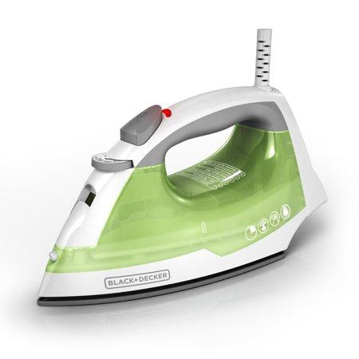
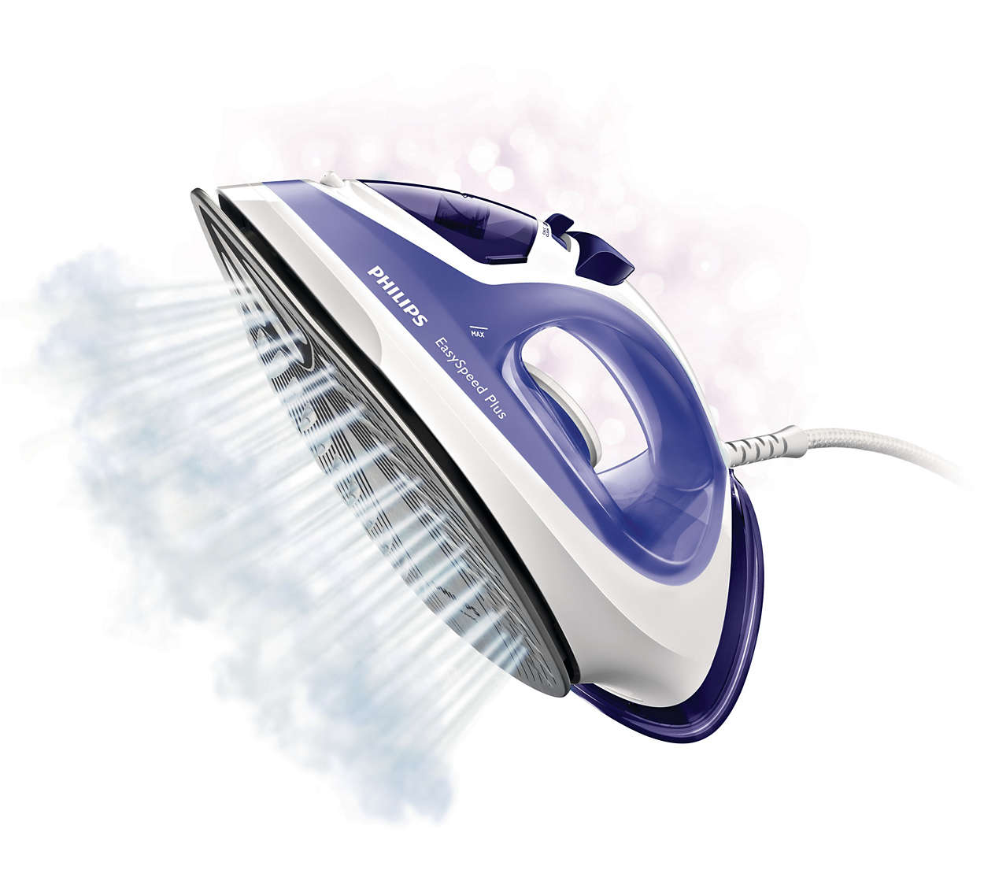
CASE STUDY - QFD OF STEAM IRON

Slide 27
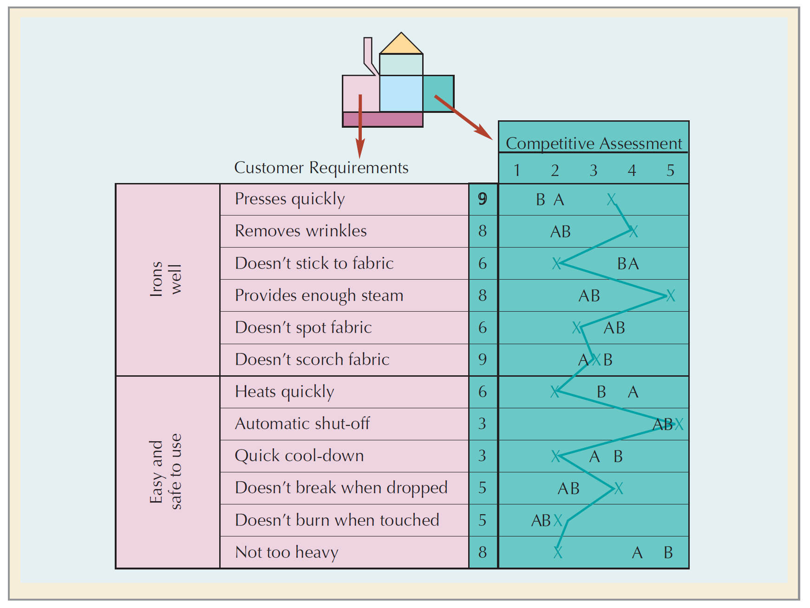
A COMPETITIVE ASSESSMENT OF CUSTOMER REQUIREMENTS

Slide 28
A COMPETITIVE ASSESSMENT OF CUSTOMER REQUIREMENTS

Slide 29
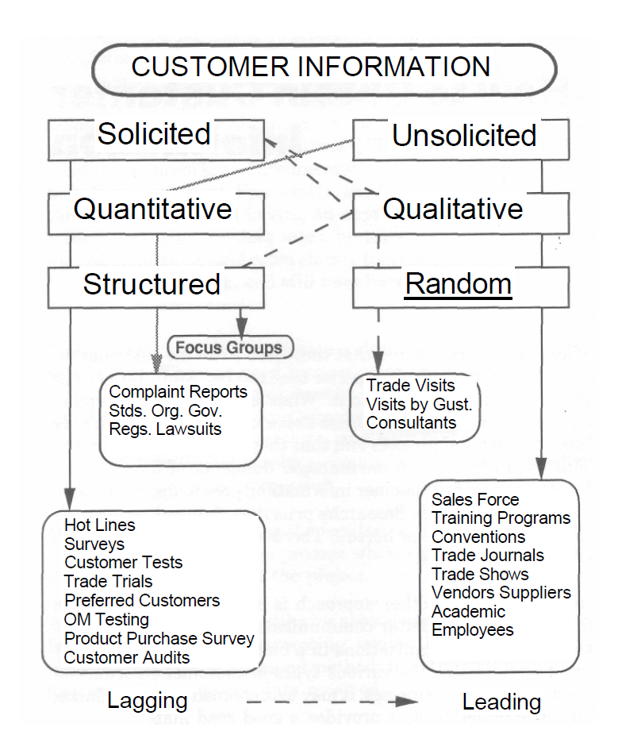
TYPES OF CUSTOMER INFORMATION

Slide 30
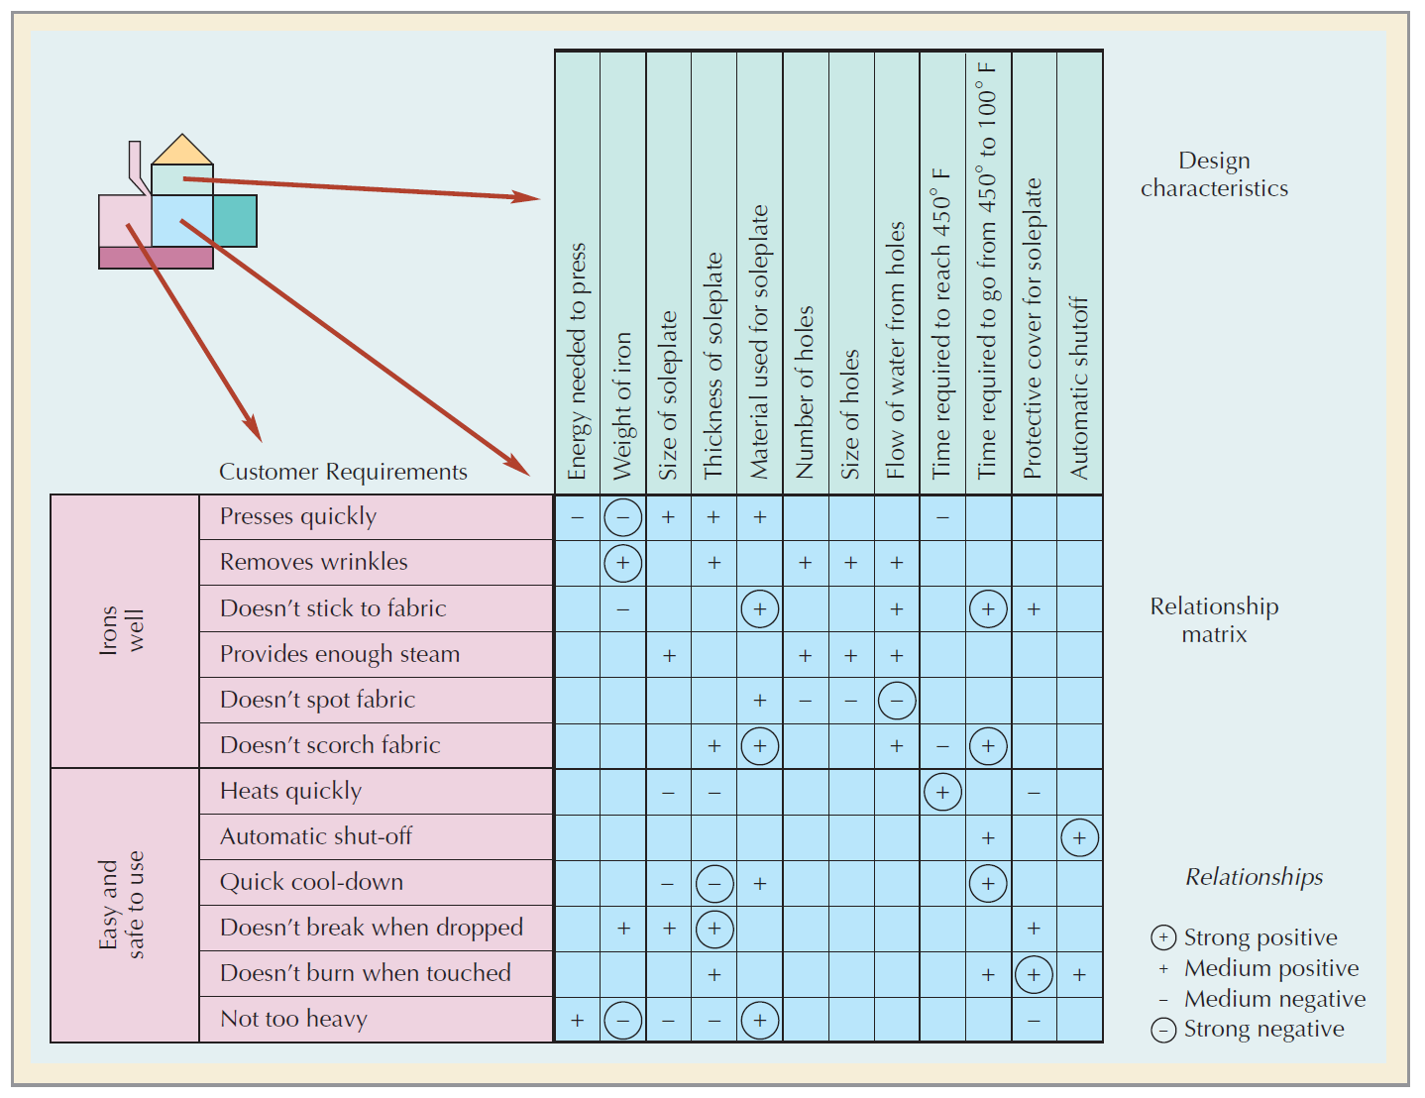
CONVERTING CUSTOMER REQUIREMENTS TO DESIGN CHARACTERISTICS

Slide 31
CONVERTING CUSTOMER REQUIREMENTS TO DESIGN CHARACTERISTICS

Slide 32
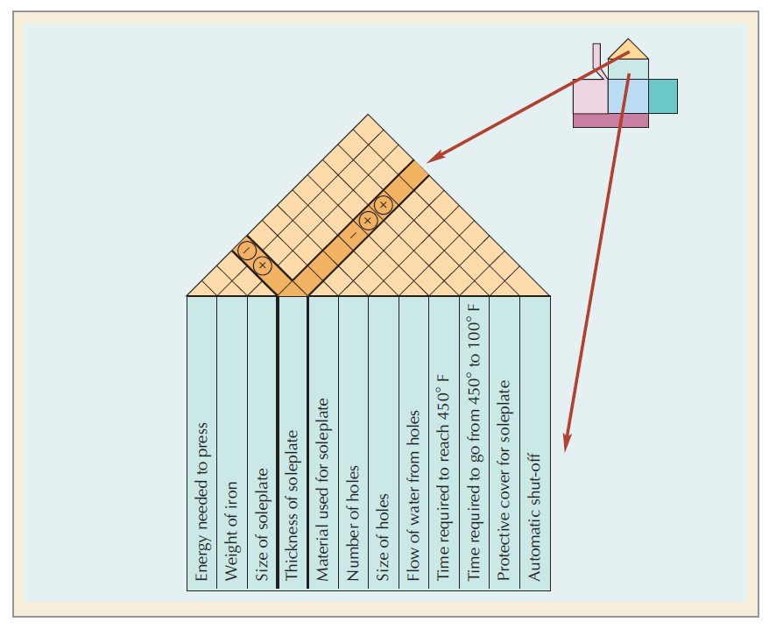
THE TRADE-OFF MATRIX

Slide 33
THE TRADE-OFF MATRIX

Slide 34
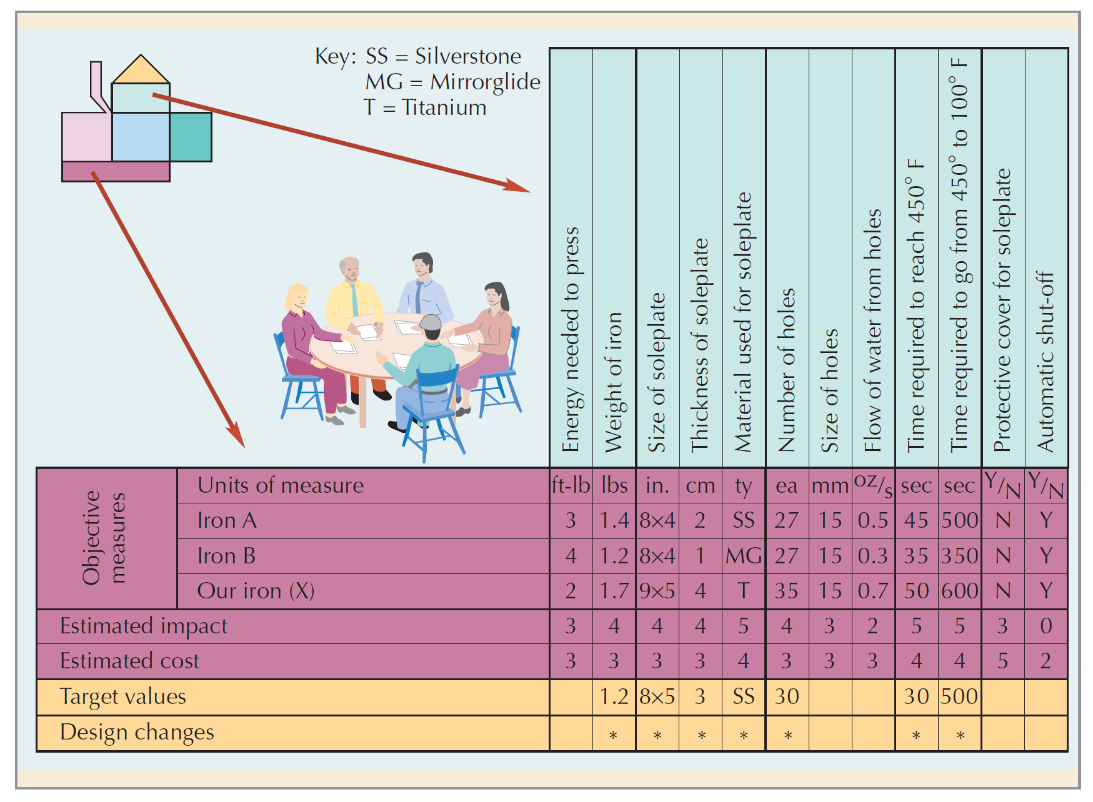
TARGETED CHANGES IN DESIGN

Slide 35
TARGETED CHANGES IN DESIGN

Slide 36
FMEA
The Biggest Recalls in 2018
The issue dealt with front seat belt pretensioners that could spark in a crash
A steering-wheel bolt that doesn’t maintain torque could loosen, allowing the steering wheel to potentially detach
The canister purge valve may become stuck in an open position, possibly causing an excessive vacuum in the fuel vapor management system, which may result in a stall
The issue at stake is for the fail-safe driving mode, which the car may not enter as intended, potentially leading to a loss of power and a stall
An airbag control unit may short circuit, preventing the frontal airbags and seat belt pretensioners from deploying
The list goes on…………….

Slide 37
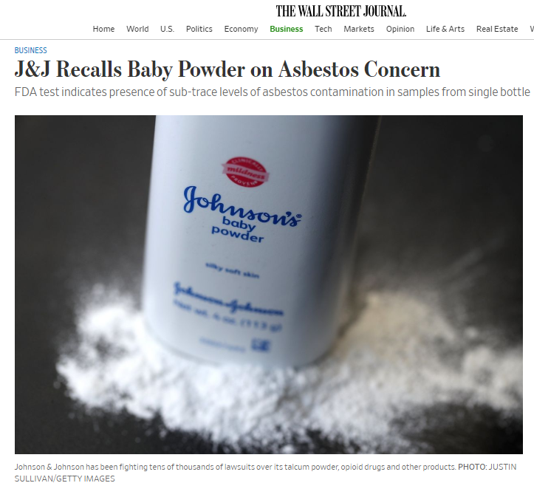
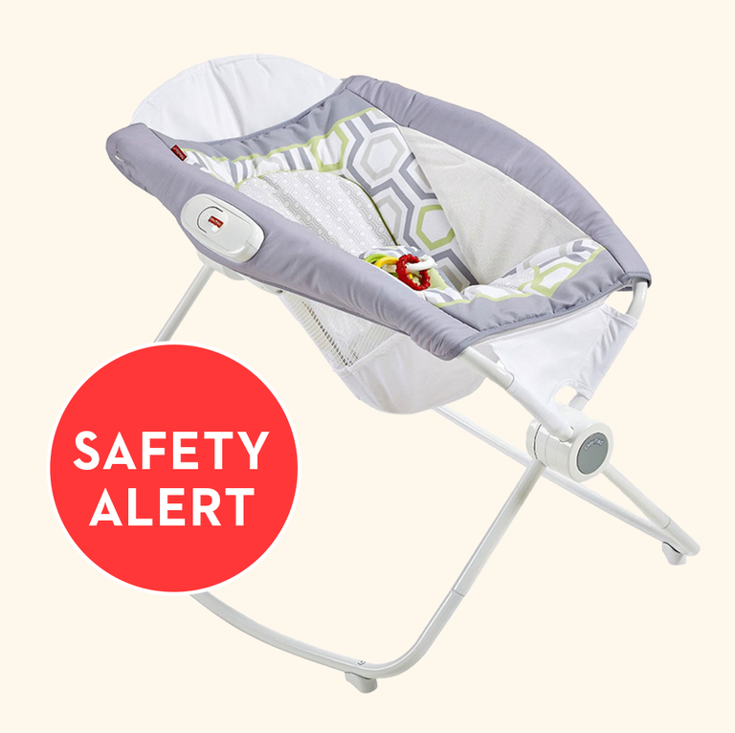
ITS NOT ONLY AUTOMOBILE PRODUCTS
Baby Products
Fisher-Price Rock 'n Play Sleeper and Kids II Rocking Sleeper Recalls
The AAP now advises against the use of any inclined sleep products for babies.
For safe sleep, babies should be put to bed on their backs, on a firm surface, in a crib or bassinet with a tight-fitting sheet and nothing else.

Slide 38
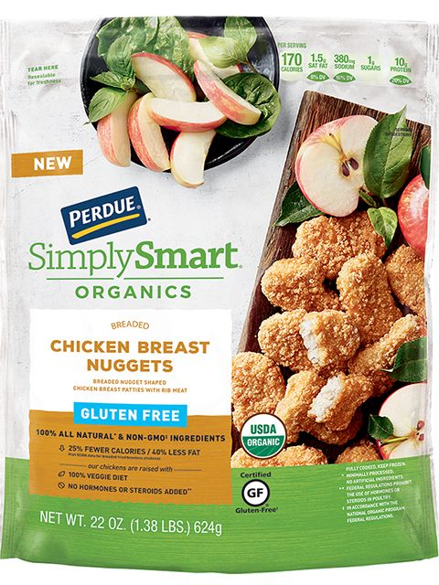

FOOD PRODUCTS
General Mills Is Recalling Bags of Gold Medal Unbleached Flour Due to Salmonella Fears
There haven't been any reported illnesses — yet.
Perdue Recalled More Than 68,000 Pounds of Chicken Nuggets for Possible Wood Contamination
Recalled packages were shipped nationwide.
Notes:
General Mills is issuing a recall on 5 pound bags of Gold Medal Unbleached Flour that have a "better if used by" date of April 20, 2020. As People reports, there was a potential presence of salmonella contamination during a sampling of the bags of flour. All other types of Gold Medal Flour are not affected by this recall.
Salmonella can cause fever, diarrhea, nausea, vomiting, and abdominal pain, but the bacteria is killed by heat through baking, frying, sautéing, or boiling products. General Mills issued a statement reminded consumers not to eat anything containing raw flour.
"Food safety is our top priority, and though we have not had any confirmed illnesses, we are voluntarily recalling this specific lot of Gold Medal Unbleached Flour to prevent potential illnesses," said Jim Murphy, president of the General Mills Meals and Baking Division. "This recall does not involve any other flour products, and we are continuing to educate consumers that flour is not a ‘ready to eat’ ingredient. Anything you make with flour must be cooked or baked before eating."
If you have a 5 lb. pound bag of Gold Medal Unbleached Flour in your home, you should dispose of it. You can contact General Mills at 1-800-230-8103 for questions or a replacement coupon.
Approximately 68,244 pounds of ready-to-eat chicken nugget products have been recalled by Perdue due to potential wood contamination, the USDA's Food Safety and Inspection Service announced on Thursday. Three consumers reported finding wood in their nuggets, with a fourth complaint reported via the FSIS’ consumer complaint monitoring system.
The USDA has classified the recall as a Class I, meaning it is a health hazard with a reasonable probability the use of the product will cause serious health consequences or death. However, there have been no confirmed reports of adverse reactions due to consumption of these products thus far.

Slide 39
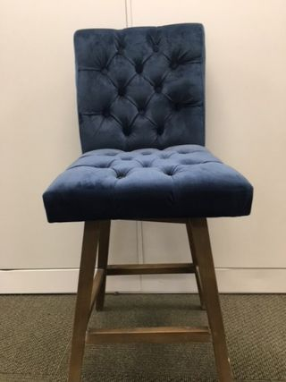
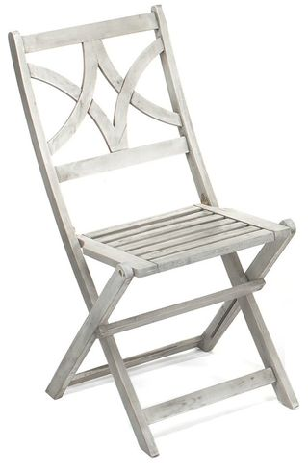
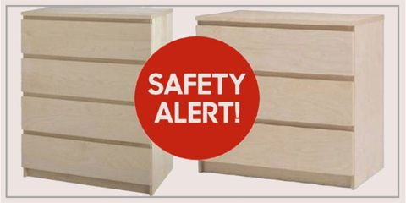
FURNITURE PRODUCTS
Another Child Has Died After an IKEA Dresser Tipped Over
It's the eighth death so far, and the first since last year's recall.
If You Bought These Chairs From HomeGoods, TJ Maxx, Or Marshall’s, Stop Using Them Immediately
More than 17,000 have been recalled.
1.6 Million Dressers Sold at Walmart Recalled for Tip-Over Risks
These pieces could fall on children and should be removed from homes with small kids immediately.
Notes:
Before you sit down, take notice: HomeGoods, TJ Maxx, and Marshall's have issued a recall for more than 17,100 barstools and chairs people bought between December 2017 and June 2018.
The first recall, which was issued on September 6, was on an estimated 1,100 TJX swivel barstools after the brand received four reports of them breaking. Three minor injuries were reported. "The wood joints on the barstool can break, posing a fall hazard," the U.S. Consumer Product Safety Commission writes of the stools, which were sold in beige, blue, and gray fabric.
U.S. CPSC
Just over a week later, the U.S. CPSC issued a recall on about 16,000 Jimco Outdoor Folding Bistro Chairs after receiving five reports of the chairs breaking — with one reported injury. The chairs were sold individually at TJ Maxx and Marshall's for approximately $20 between January 2018 and June 2018, and as part of a set (which consisted of two chairs and a table) for $130 at HomeGoods and Sierra Trading Post during the same time period. Posing a similar fall hazard as the barstools, the graywash and teak-finished Jimco chairs were recalled because "the chair's seat can break," according to the U.S. CPSC.
U.S. CPSC
In both cases, the U.S. CPSC advises consumers to stop using the recalled items immediately and call the appropriate store for instructions on how to return them for a full refund. Not sure if your item is part of the recall? You can check the number on the hangtag for the the TJX barstool here or the Jimco bistro chair here.

Slide 40
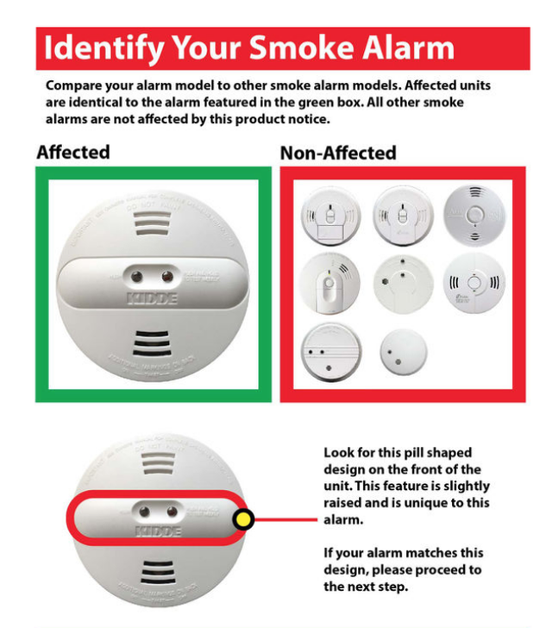
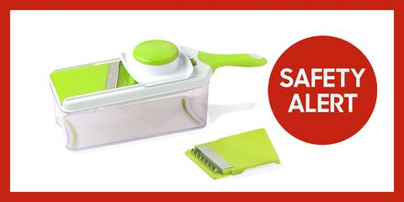
19,000 Mandoline Slicers Have Been Recalled Due to Laceration Hazard
They popular kitchen products were sold at Target, Kohl's, and HomeGoods.
Over 450K Kidde Smoke Alarms Recalled for Failure to Sense Fires
It's so important to check if your detector is one of the affected products.
Notes:
Kidde has announced a recall of 452,000 smoke alarms after finding that they may not go off when there is a fire. A yellow cap was left on during manufacturing and can cover one of the two sensors, making it harder for the alarm to detect smoke.
The recall involves Kidde dual sensor smoke alarms that were sold between September 2016 and January 2018 at The Home Depot, Walmart, Amazon, and more. The Consumer Product Safety Commission has received one report of a yellow protective cap being present, but no incidents or injuries have been reported to date.
Premier Kitchen Products has announced a recall of nearly 19,000 mandoline slicers after finding that small blades can separate from the plastic potentially resulting in a laceration hazard.
The recall affects the Sharper Image and Frigidair mandoline slicers sold at Target, HomeGoods, Kohl's, and other retailers between May 2017 and April 2018 for between $13 and $30. The slicers come with a clear plastic container used to capture food, as well as two blade attachments that are either light green or blue.
The affected Sharper Image mandoline slicers have a model number of 12SP1006 and a UPC Code of 709996669580. The affected Frigidaire Slicers have a model number of 12EP203 and a UPC code of 709996709118. You can locate these numbers on the product’s packaging of your model.
The Consumer Product Safety Commission has received four reports of small blades separating from the julienne attachment during food preparation. While no injuries have been reported, they ask that consumers stop using the affected products immediately and visit pkp-recall.com for instructions on how to receive a refund in the form of a gift card.
You can contact Premier Kitchen Products at 800-304-4035 from 9 a.m. to 5 p.m. ET Monday through Friday or by emailing recall@pkpny.com.

Slide 41
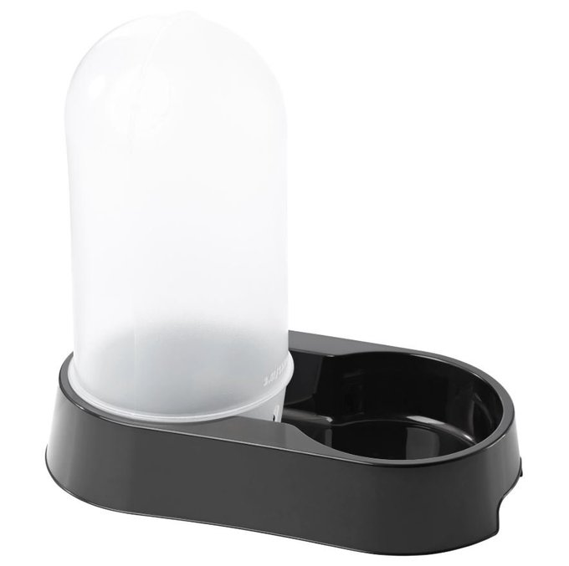

EVEN FOR ANIMAL’S PRODUCTS
IKEA Recalls 16,700 Pet Water Dispensers After 2 Dogs Die
Animals can suffocate if their heads get stuck in the water tank.
Notes:
After the reported deaths of two dogs, IKEA is recalling 16,700 water dispensers sold in the United States for a suffocation hazard. The $7.99 product from the Swedish retailer's recently-launched pet line featured a large, clear well that replenished a drinking bowl as needed.
However, the inverted tank can entrap smaller dogs and cats' heads and poses a major safety risk. IKEA is now urging all customers to stop using the dispensers immediately and return them for a full refund.

Slide 42
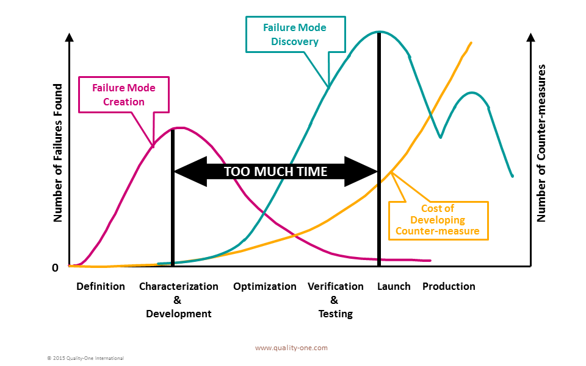
LATE FAILURE MODE DISCOVERY

Slide 43
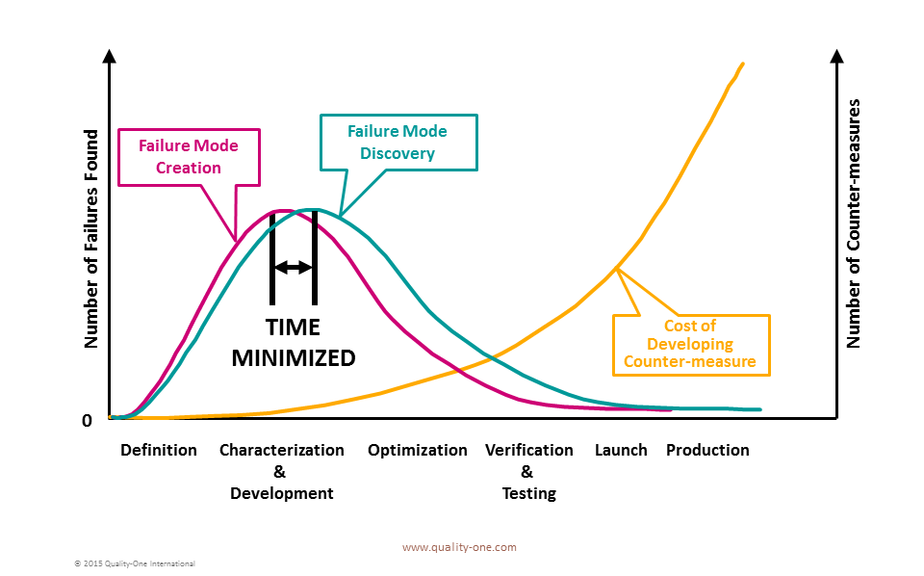
EARLY FAILURE MODE DISCOVERY

Slide 44
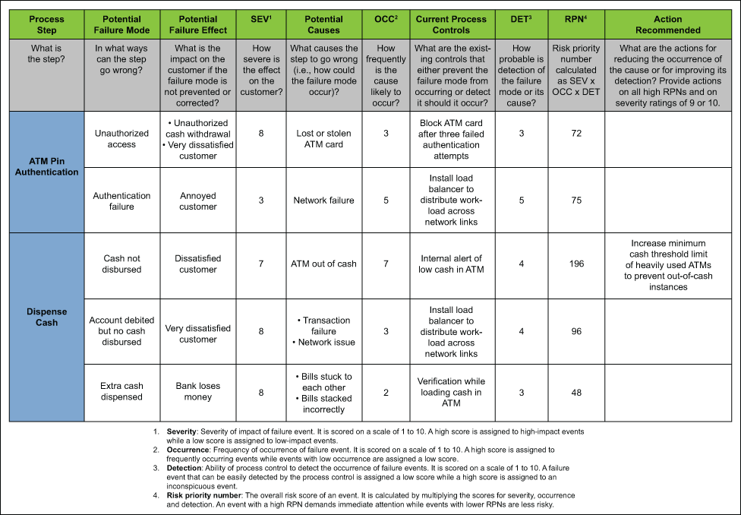
FMEA TEMPLATE

Slide 45
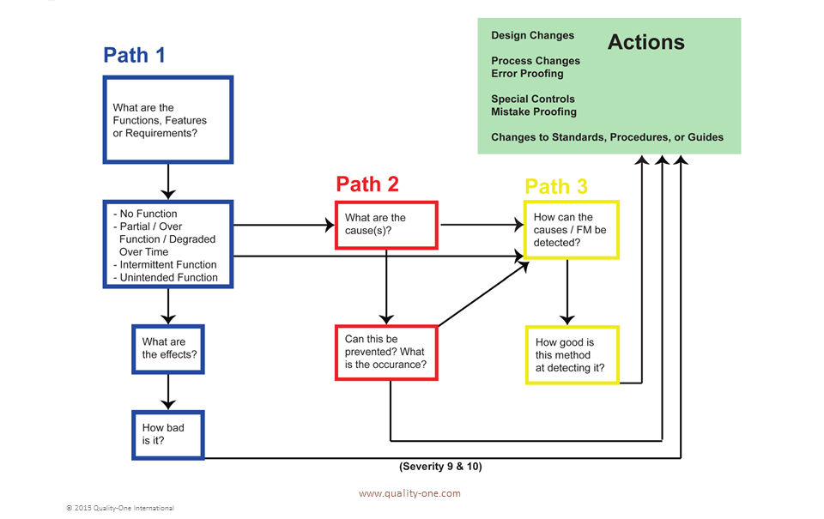
FMEA MODELS

Slide 46
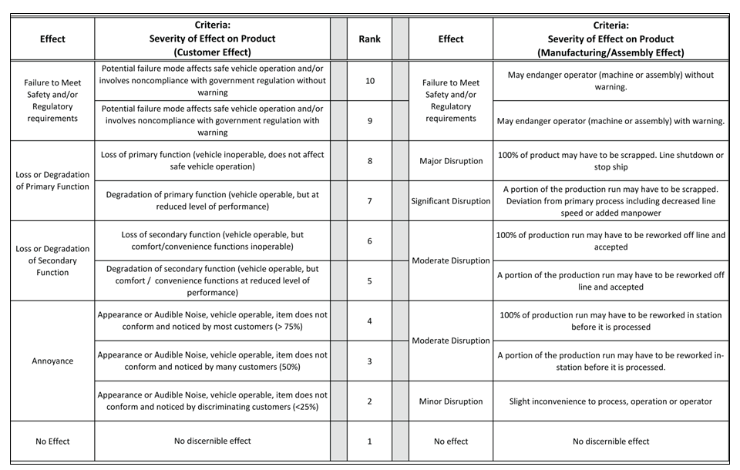
SEVERITY OF EFFECT

Slide 47
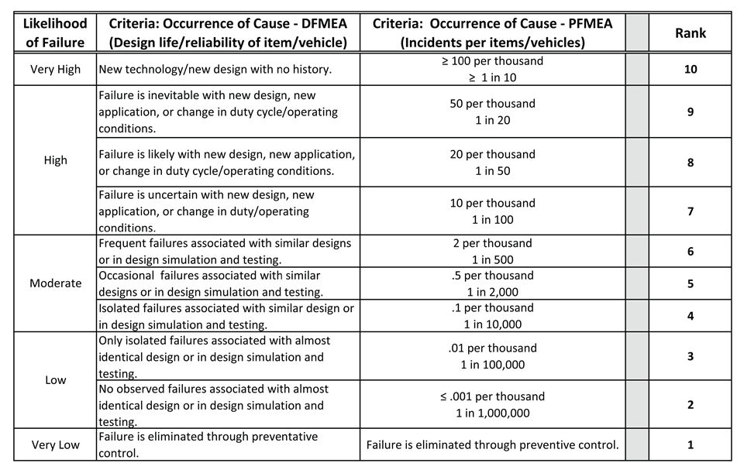
OCCURRENCE OF CAUSE

Slide 48
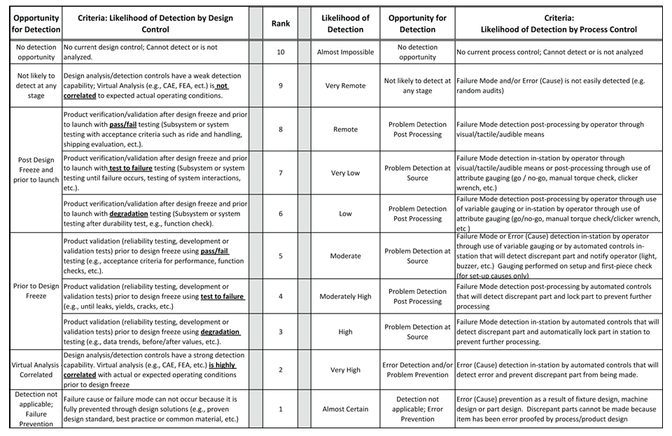
DETECTION

Slide 49
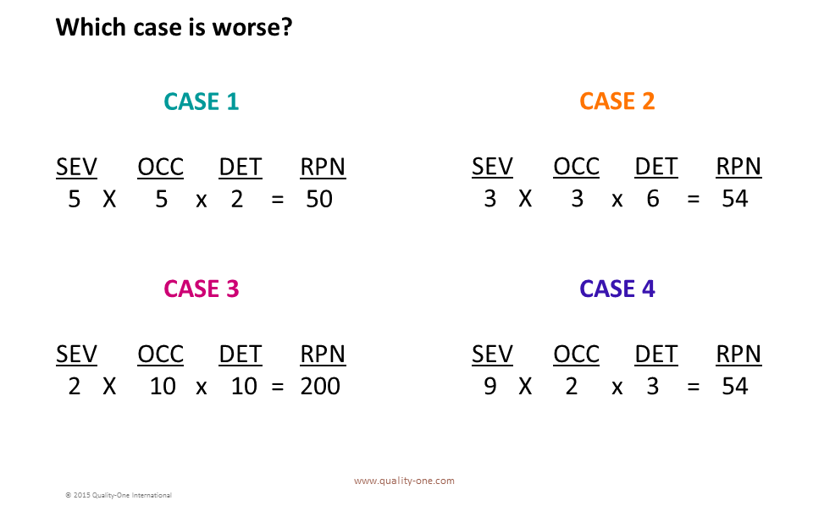
RPN – RISK PRIORITY NUMBER

Slide 50
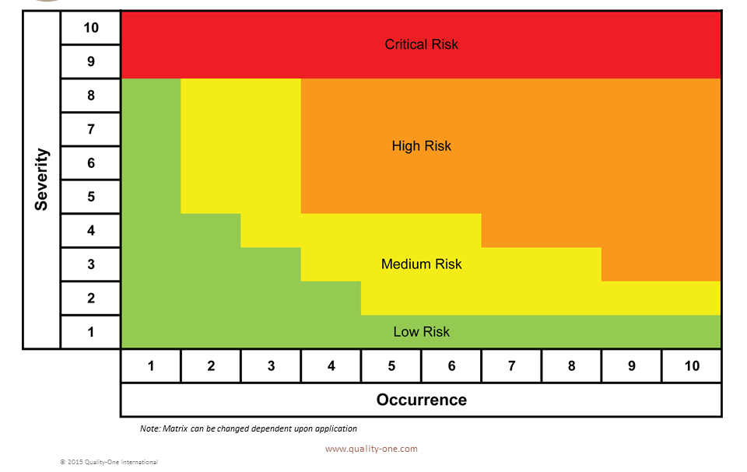
FMEA CRITICALITY MATRIX

Slide 51
RPN ACTION PRIORITY
When risk is determined to be unacceptable, a priority of action to be applied as follows:
Error Proofing (Eliminate Failure Mode or Address Cause)
Failure Mode (Only Severity of 9 or 10)
Causes with High Occurrence
Improve Potential Process Capability
Increase Tolerance (Tolerance Design)
Reduce Variation of the Process (Statistical Process Control and Process Capability)
Improve Controls
Mistake Proofing of the tooling or process
Improve the inspection / evaluation techniques

Slide 52
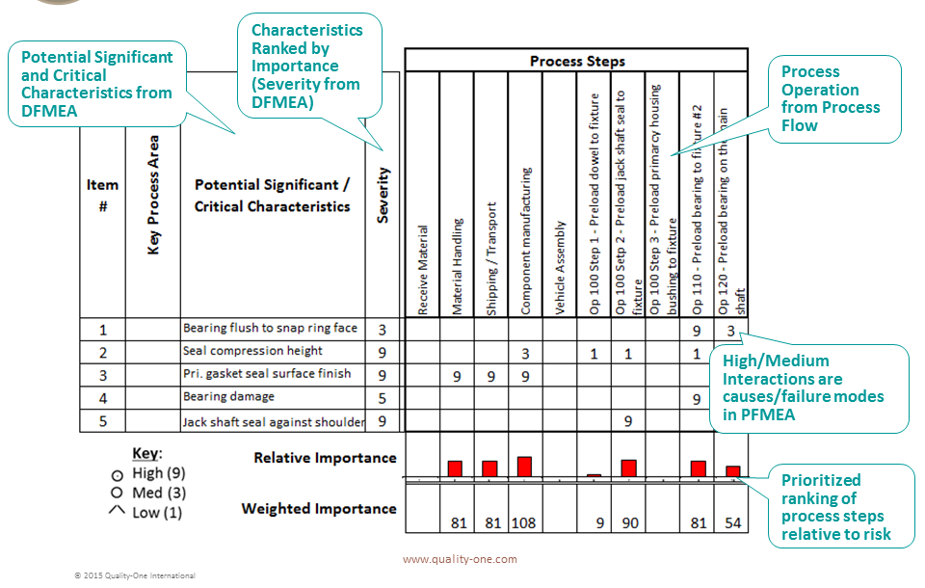
CHARACTERISTICS MATRIX

Slide 53
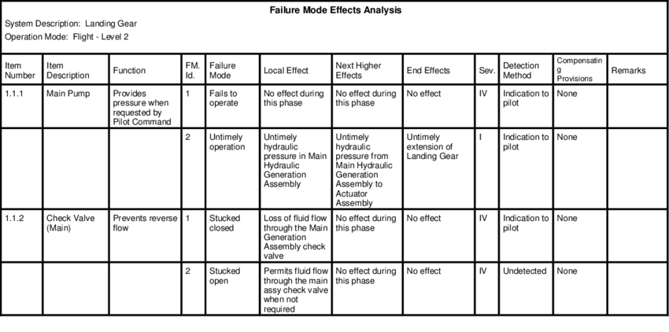
INDUSTRIAL APPLICATION OF FMEA

Slide 54
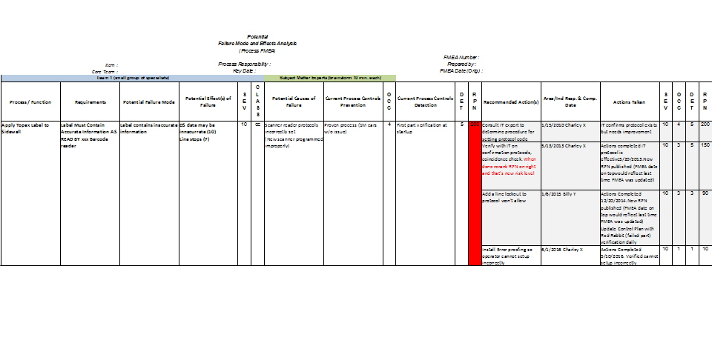
EXAMPLE

Slide 55
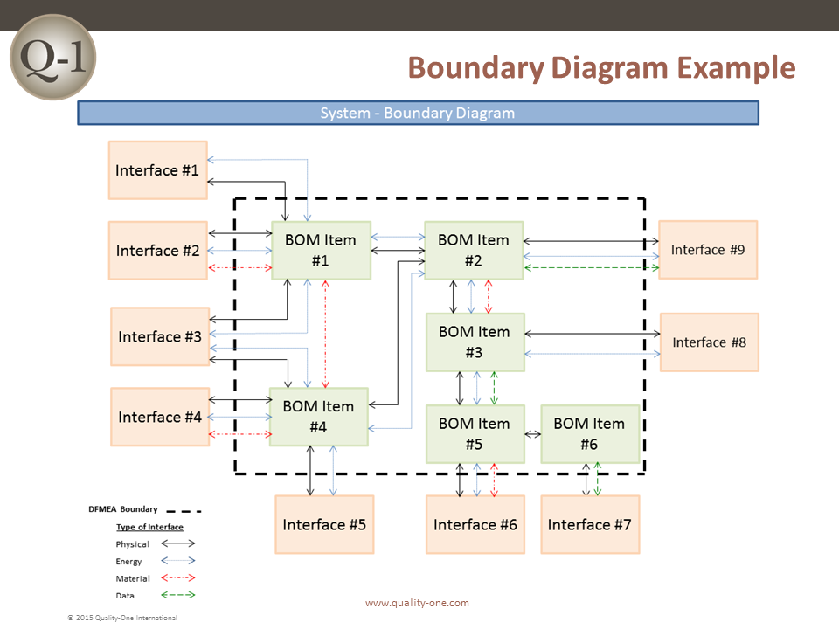

Slide 56
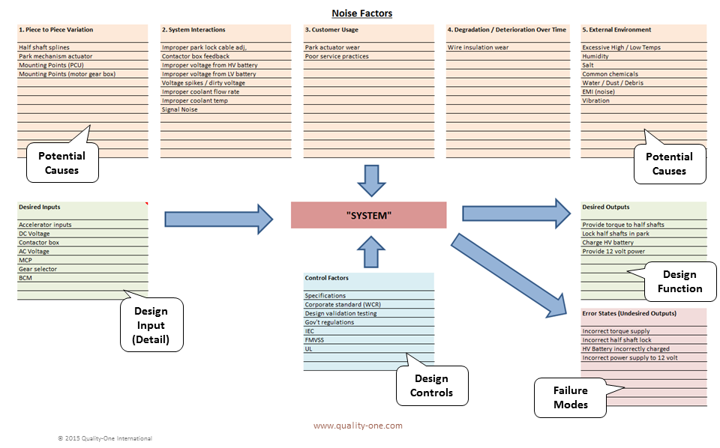
PARAMETER (P) DIAGRAM

Slide 57
DESIGN FOR MAINTENANCE
MTTF
MTBF
MTTR
FIT
For other topics like OEE, Design considerations for Maintainability and Cases related to Design for Maintenance , refer class notes.

Slide 58
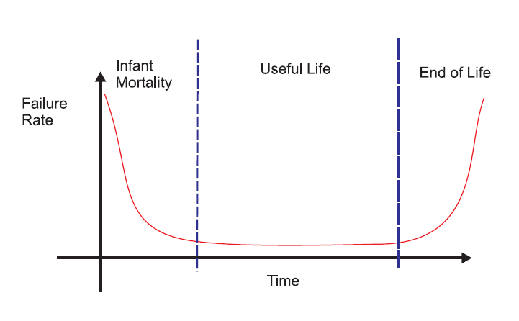
RELIABILITY BATH TUB CURVE
Notes:
Early Life
If we follow the slope from the leftmost start to where it begins to flatten out this can be considered the
first period. The first period is characterized by a decreasing failure rate. It is what occurs during the “early
life” of a population of units. The weaker units fail leaving a population that is more rigorous.
Useful Life
The next period is the flat bottom portion of the graph. It is called the “useful life” period. Failures occur
more in a random sequence during this time. It is difficult to predict which failure mode will occur, but the
rate of failures is predictable. Notice the constant slope.
Wearout
The third period begins at the point where the slope begins to increase and extends to the rightmost end
of the graph. This is what happens when units become old and begin to fail at an increasing rate. It is
called the “wearout” period.

Slide 59
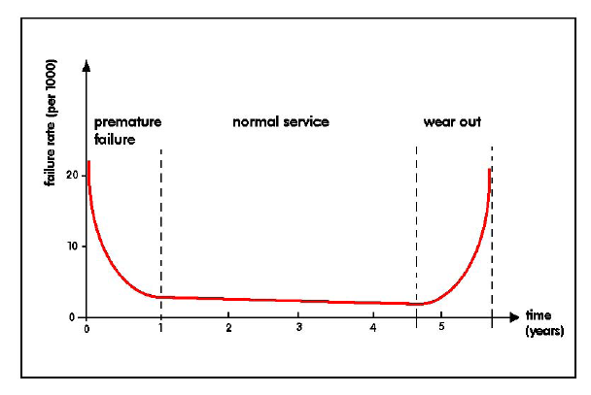
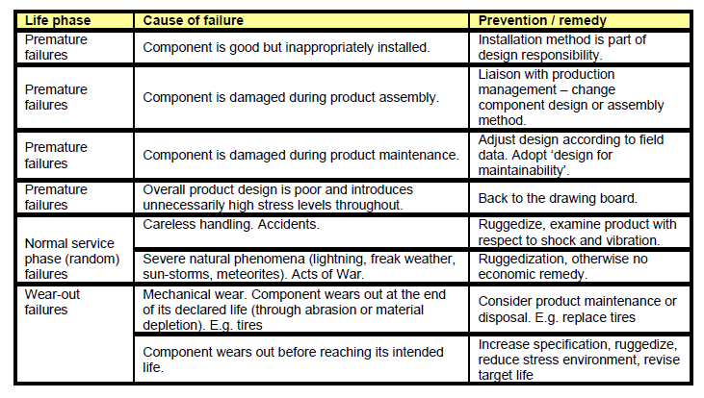

Slide 60
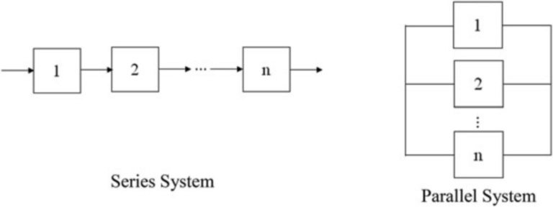
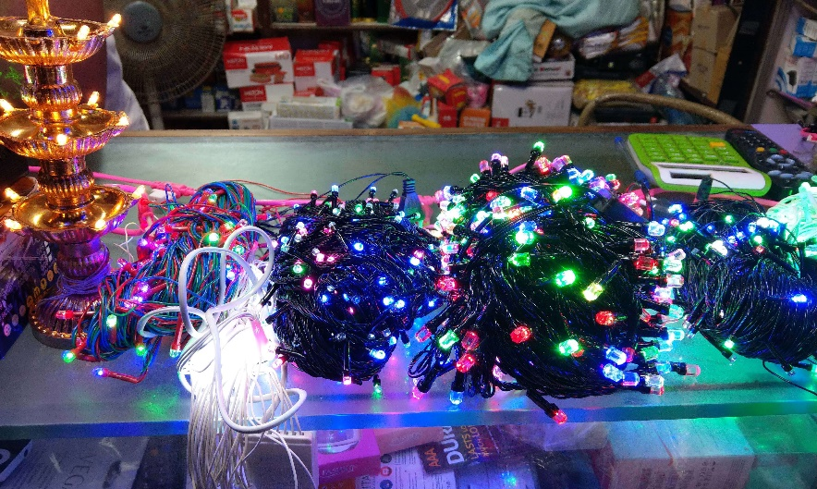
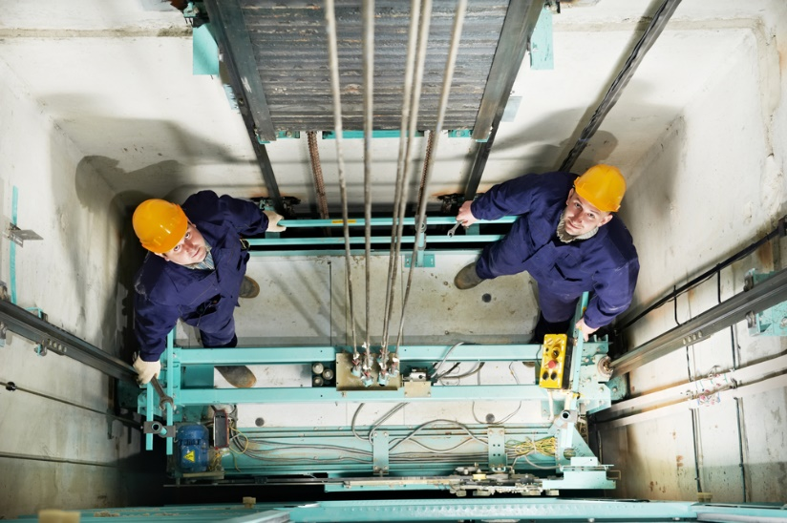
RELIABILITY :: SERIES & PARALLEL

Slide 62
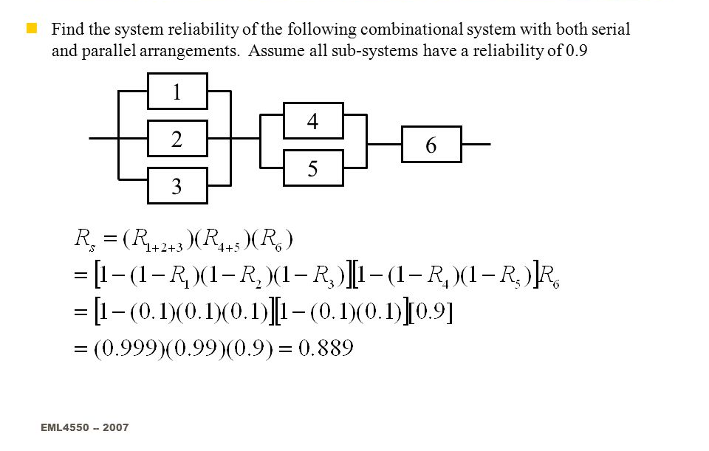

Slide 63
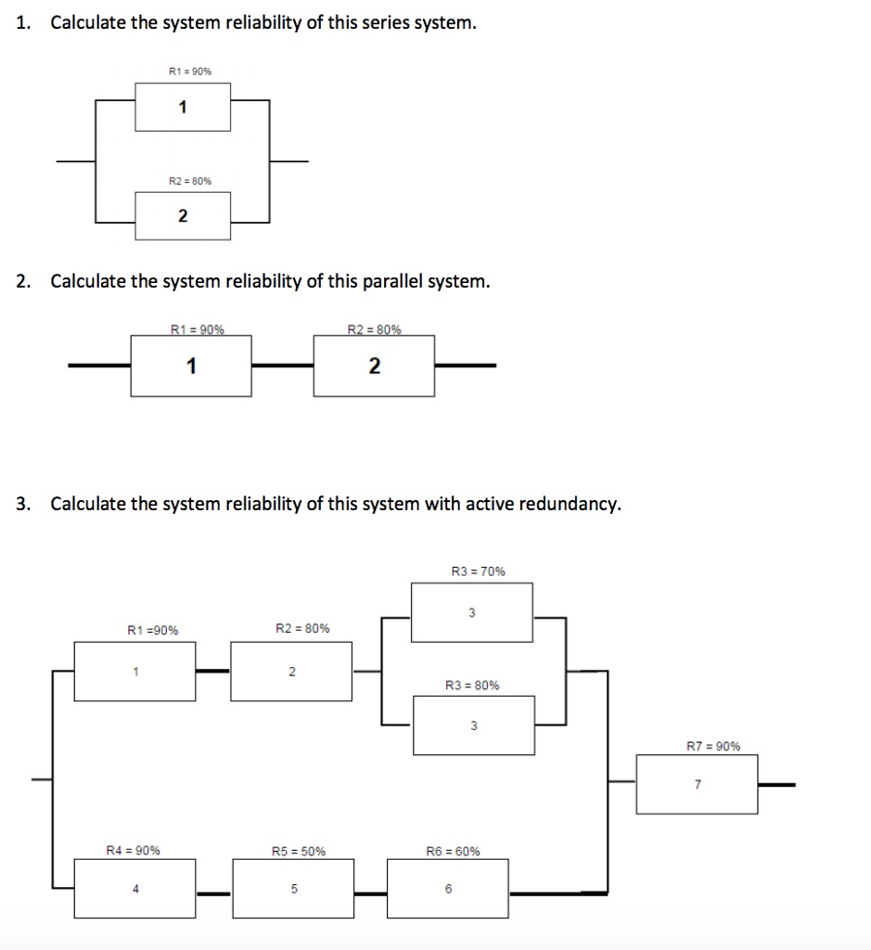

Slide 64

MTTF

Slide 65
CRYO COOLER CASE - MTTF
The global Cryocooler Market is projected to grow from USD 1.96 Billion in 2016 to USD 2.99 Billion by 2022, at a CAGR of 7.00% between 2017 and 2022, as per a report by MarketsandMarkets
How advancement of cryocoolers in microsatellite military applications present an opportunity?
Why performance constraint of cryocoolers remain a challenge?
Their mean-time-to-failure (MTTF) of about 4,000 hours (approximately 0.5 year) is short of the required 5–10 years lifetime needed for satellite applications and even 3–5 years lifetime for most commercial applications.
Also, achieving high reliability is a key design driver for cryogenic systems to provide continuous cooling.
Notes:
https://dailytribune24.com/2019/11/15/key-emerging-trends-in-cryocooler/

Slide 66

INTEGRATED CIRCUIT (IC)
Unquestionably one of the greatest inventions of all time.
This technology has transformed our world
ICs have vulnerabilities that can affect long-term reliability, leading to premature failure of the systems that employ them
Defence Industry – High or Lon-term Reliability
PLC- Industrial Control Systems
Automotive Industry - Engine controllers, Anti-lock braking systems, Chassis controls, Transmissions, and Driver comfort and Assistance systems
Air bags are critical to occupant safety, so reliability is paramount
To estimate the mean time to failure (MTTF) of an IC due to electromigration, James Black of Motorola developed an empirical model in 1969 now referred to as Black’s equation:
where A is a constant, j is the current density, n is the model parameter, Q is the activation energy, k is Boltzmann’s constant and T is temperature.

Slide 67

MTBF

Slide 68


Slide 69
MTBF
MTBF — MTBF (mean time between failures) is a measure of how reliable a hardware product or component is over its expected lifetime. For most components, the measure is typically in thousands or even tens of thousands of hours between failures.
For example, a hard disk drive may have a mean time between failures of 300,000 hours, while an SSD might have 1.5 million hours.
This doesn’t mean that your SSD will last that many hours, what it means is, given a sample set of that model of SSD, errors will occur at a certain rate. A 1.2 million hour MTBF means that if the drive is used at an average of 8 hours a day, a sample size of 1,000 SSDs would be expected to have one failure every 150 days, or about twice a year

Slide 70
EXAMPLE
A power supply with an MTBF of 40,000 hours does not mean that the power supply should last for an average of 40,000 hours. According to the theory behind the statistics, the statistical average becomes the true average as the number of samples increase. An MTBF of 40,000 hours, or 1 year for 1 device, becomes 40,000/2 for two devices and 40,000/4 for four devices.

Slide 71

MTTR

Slide 72


Slide 73


Slide 74


Slide 75

PROBLEM TYPE-1
A manufacturing workshop have 20 machines. They are operated for 250 hours. Two machine fails in 150 hours and another one Fails in 160 hours. What is the mean time between failures and Reliability of the machines?
17 of the machines ran for 250 hours, while two others ran for 150 hours and another one for 160 hours each.
The total running time is 17 (250) + 150*2 + 160*1 = 4710, and
MTBF = 4710 / 3 = 1570 hours / failure
Failure Rate : λ= 1/1570 = .0006369 failure/hour
R(T) = e^(-0.0006369 * 250) = 0.852795

Slide 76
PRACTICE
A manufacturing workshop have 20 machines. They are operated for 250 hours. Two machine fails in 150 hours and another one Fails in 160 hours. What is the mean time between failures and Reliability of the machines?
What is the reliability of the same machines in above example at 500 hours? 900 hours?
What is the reliability of the same machines , if number of machines reduced to 15 (keeping failed machines remains unchanged) in above example at 500 hours? 900 hours?

Slide 77

TYPE-2
If certain software product has a mean time between failures of 5,000 hours and has a mean time to repair of 40 hours. If the product is used by 10 customers, what is its availability?

Slide 78
PROBLEM – TYPE 3
A CNC simulator may be obtained from two vendors. Vendor A’s CNC simulator costs $15000 and Vendor B’s CNC simulator costs $18000. Vendor A’s is less reliable with a MTTF of 1800 days while Vendor B’s MTTF is 2600 days. Vendor A’s CNC simulator has a more modular design and is therefore easier to replace with a MTTR of 24 hr while Vendor B’s CNC simulator takes 36 hr. to replace. If a failed CNC simulator must be replaced at its unit cost, which CNC simulator should be used?
The labor rate is $45 per hour and the design life of the CNC simulator is considered to be 10 yr.

Slide 79
ANALYSIS
Vendor A: 15000 + (10 x 365 / 1800) [15000 + 45 (24) ] = $ 47607
Vendor B: 18000 + (10 x 365 / 2600) [18000 + 45 (36) ] = $ 45543

Slide 80
SELECT BETTER OPTION
 | A | B | C
Purchase Cost | 25,00,000 | 30,00,000 | 27,00,000
MTBF | 5000 Days | 6500 Days | 4500 Days
MTTR | 4 days | 6 days | 3 days
Repair Labour rate / day | 3000 | 1800 | 2200
Design Life | 20 Years | 20 Years | 20 Years

Slide 81


Slide 82

RELIABILITY PROBLEM & REMEDY

Slide 83


Slide 84
DFX
Design for Safety
Design for Recycling,
Design for Environment,
Design for Logistics,
Design for Delayed differentiation,
Design for Ergonomics,
Design for Additive Manufacturing,
Case studies based on above DFX concepts

Slide 85
DESIGN FOR SAFETY
For other topics like Safety regulations, Design considerations for Safety and Cases related to Design for Safety , refer class notes.

Slide 86
SAFETY CRITICAL DESIGN:
Over-specification: For product applications in the building and construction industry, it is standard practice to include a ‘x5’ safety factor in all material strength calculations. For example: a suspension bracket for a 10kg light fitting will be designed to carry at least 50kg.*
Redundancy (parallel): Multiple identical components are used simultaneously, any one of which would be capable of supporting normal product function. For example, a passenger lift has 4 cables carrying the lift cabin, all sharing the load. Any one cable would be capable of carrying the full passenger lift load. A failure of up to 3 cables will not endanger the lift occupants. Flight control and instrument systems in some aircraft adopt a similar strategy. Dual wiring in military systems improves survivability

Slide 87
SAFETY CRITICAL DESIGN:
3) Redundancy (standby): A back-up system is held in reserve and comes into operation only when the main system fails, for example stand-by generators in hospitals, and reserve parachutes. * The light fitting mentioned above might have a safety chain loosely fitted, to catch the light fitting if the support bracket fails. The chain would be an example of standby redundancy. Standby redundancy is often described as a ‘belt & braces’ approach
4) Fail-safe design: Assumes an inherent risk of failure for which the cost of any of the above three strategies would be prohibitively high. The product or system is designed to drop into a safe condition in the event of partial or total failure.

Slide 88
SAFETY CRITICAL DESIGN:
Examples:
i. The gas supply to a domestic central heating boiler is shut off in the absence of a ‘healthy’ signal from the water pump, flame sensor, water pressure sensor, or exhaust fan.
ii. Toys can be designed to fracture at pre-determined weak points so as to leave no sharp projections that would injure a child.
iii. Railway train brakes are released by vacuum, and applied by admitting air. If a brake pipe bursts, the admitted air automatically applies the train brakes.

Slide 89

DF RECYCLING

Slide 90


WASTE HIERARCHY

Slide 91

1. Reduce: The amount of waste produced
“Is this a need or a want?”.
How long do you foresee yourself using the item?
Will it truly add value in your life?
Are there any other alternative eco products?
2. Reuse: Materials as much as possible
“Waste nothing, use everything”
Reconsider if the item can be reused for any other purposes!
4. Recover: Energy from waste
Recovery of energy from waste is a novel concept
Garbage to Biofuel
Solid waste to Electricty
3. Recycle: Everything you can
Recycling saves scarce resources and enables us to use a raw material that would otherwise be landfilled.
Products made from recycled material have a considerably lower carbon footprint than those produced from virgin materials.
5. Landfill: The last choice.
Unless you really cannot practice the 4 levels of the hierarchy aforementioned, then it will end up in the landfill.

Slide 92


Slide 93





RECYCLING MATERIALS

Slide 94



PAPER

Slide 95


Slide 96





PLASTIC & PET

Slide 97



PVC

Slide 98


Design For Delayed Differentiation
Case Study
Paint - AP
Apparel - UCB
Automobiles

Slide 99



DESIGN FOR LOGISTICS
Case Study
Line Haul Cost
Laid Down Cost
Unassembled vs Assembled Products
Density

Slide 100


Design for Delayed differentiation

Slide 101


DESIGN FOR DELAYED DIFFERENTIATION

Slide 102


DFX
Design for Ergonomics,
https://www.hfes-europe.org/bad-ergonomics/

Slide 103
THANK YOU
PREPARE WELL….PERFORM BEST

